Slide 1
The adaptive immune system
The adaptive immune system
Introduction

Slide 2
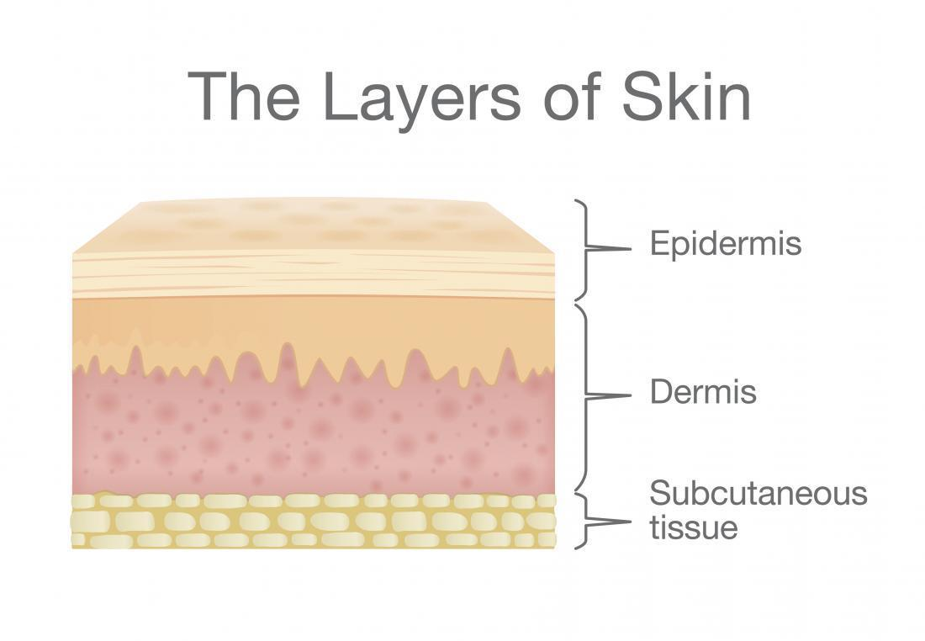
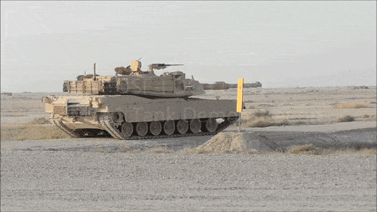
Organisation of immune defences
Barriers
Innate
(non-specific)
Adaptive
(specific)
Notes:
These are some of the words and phrases you will be constantly using while studying this topic. You will notice that some of the words are interchangeable and some components have two names – very confusing!
This organisational chart demonstrates the three lines of the body’s defence system:
(use pointer) the physical barriers and non-specific cellular systems we learned about last year and the specific defence systems that we are going to learn about in the next couple of lectures.
Even though we have looked at the three lines of defence separately, it is important to remember they act together and interact with each other

Slide 3
Organisation of immune defences
Protein component of your blood
Cells in tissues, blood and immune organs
Barriers
Innate
(non-specific)
Complement
Cellular
(cell mediated)
Adaptive
(specific)
Humoral
(antibody mediated)
Cellular
(cell mediated)
Notes:
These are some of the words and phrases you will be constantly using while studying this topic. You will notice that some of the words are interchangeable and some components have two names – very confusing!
This organisational chart demonstrates the three lines of the body’s defence system:
(use pointer) the physical barriers and non-specific cellular systems we learned about last year and the specific defence systems that we are going to learn about in the next couple of lectures.
Even though we have looked at the three lines of defence separately, it is important to remember they act together and interact with each other

Slide 4
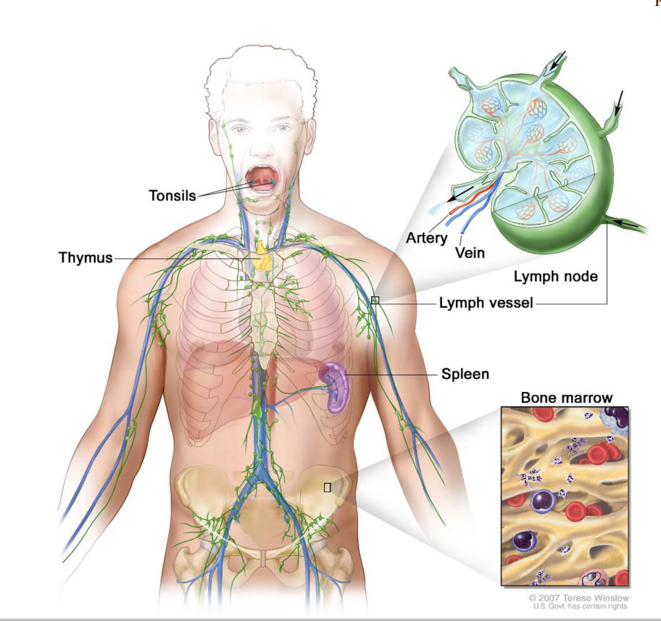
The anatomy
Moore JE Jr, Bertram CD. Lymphatic System Flows. Annu Rev Fluid Mech. 2018;50:459-482.

Slide 5
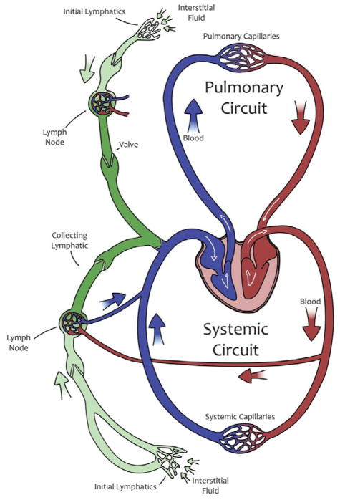
The anatomy
Moore JE Jr, Bertram CD. Lymphatic System Flows. Annu Rev Fluid Mech. 2018;50:459-482.

Slide 6
B cells
T cells
APC cells
What the heck are the spleen and the lymph nodes?
Wendland M, Willenzon S, Kocks J, Davalos-Misslitz Ana C, Hammerschmidt Swantje I, Schumann K, Kremmer E, Sixt M, Hoffmeyer A, Pabst O, Förster R (2011) Lymph Node T Cell Homeostasis Relies on Steady State Homing of Dendritic Cells. Immunity 35 (6):945-957.

Slide 7
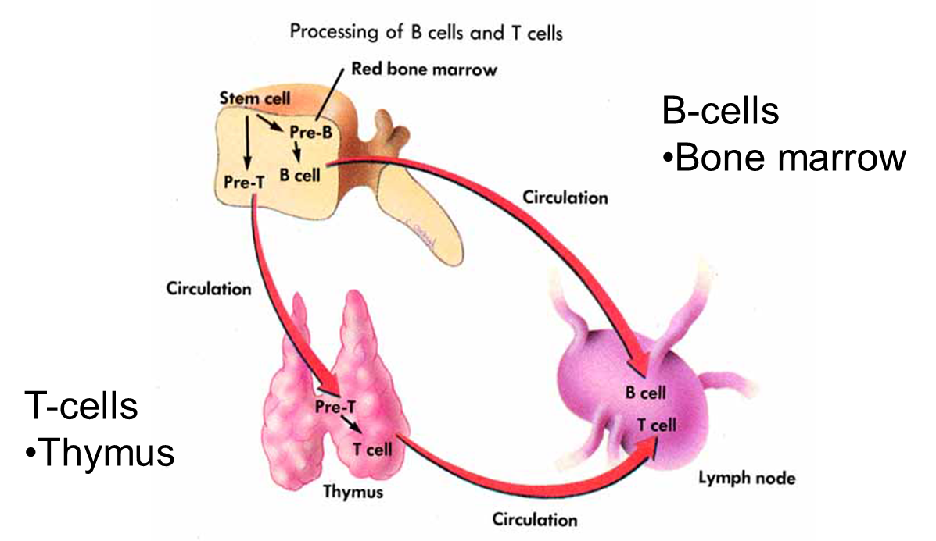
Cells of the adaptive immune system: B and T lymphocytes
Notes:
And now the other cells of the specific immune system; the T and B lymphocytes
Lymphocytes originate in red bone marrow, just like the other blood cells: red blood cells, white blood cells and platelets
CLICK B cells mature in bone marrow and migrate to lymphoid tissue: lymph nodes, tonsils, spleen, where they wait to be activated to develop into plasma cells that produce a specific antibody that binds to the foreign antigen, inactivating them temporarily and marking them for destruction by other cells and proteins of the immune system.
CLICK T cells migrate from bone marrow and mature in the thymus gland and then migrate to lymphoid tissue
T cells are conditioned by hormones in the thymus gland and part of that conditioning is removal of T cells which can attack self.
As T and B lymphocytes mature, they develop unique receptors on their cell membrane which enables them to recognise and bind to specific foreign antigens. So T and B cells can respond to the same antigens – the same invaders, but in different ways. This is very important for the control of immune responses, which we will examine in more depth in L4

Slide 8
The adaptive immune system
B cells
The adaptive immune system

Slide 9
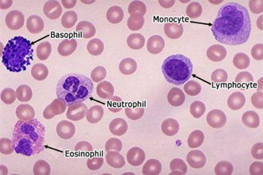
Basic background the B cell

Slide 10
Basic background the B cell

Slide 11
Basic background the B cell

Slide 12
Basic background the B cell
Variable antigen binding region

Slide 13
The problem
We have ~27,000 protein coding genes
B-cell receptors (antibodies) are proteins
There are ~100000000000 different antibodies in our body

Slide 14
The Solution
Self genetic engineering

Slide 15
Gene for antibody
Pro-B cell

Slide 16
Pro-B cell
Pre-B cell
Somatic recombination
Self genetic engineering

Slide 17
RSS (recombination signal sequences)
RAG (recombination activating genes – proteins)
Somatic recombination

Slide 18
What happens after binding

Slide 19
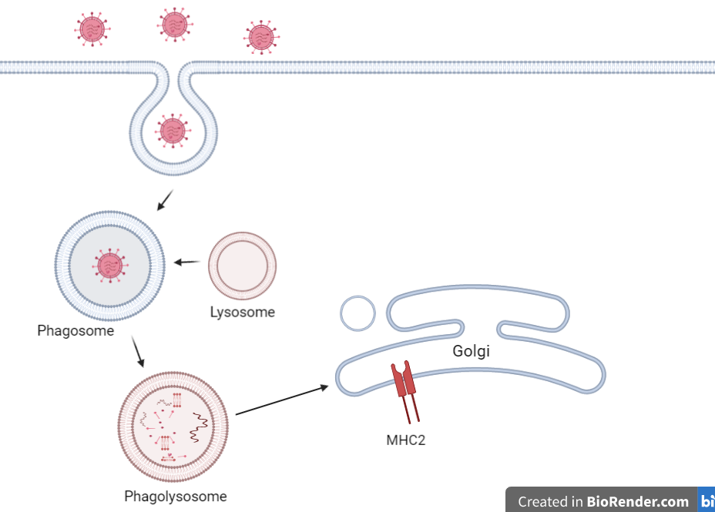

Slide 20
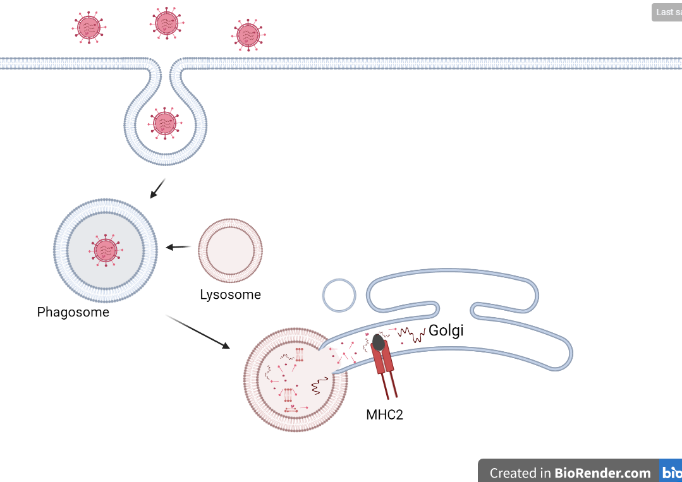

Slide 21
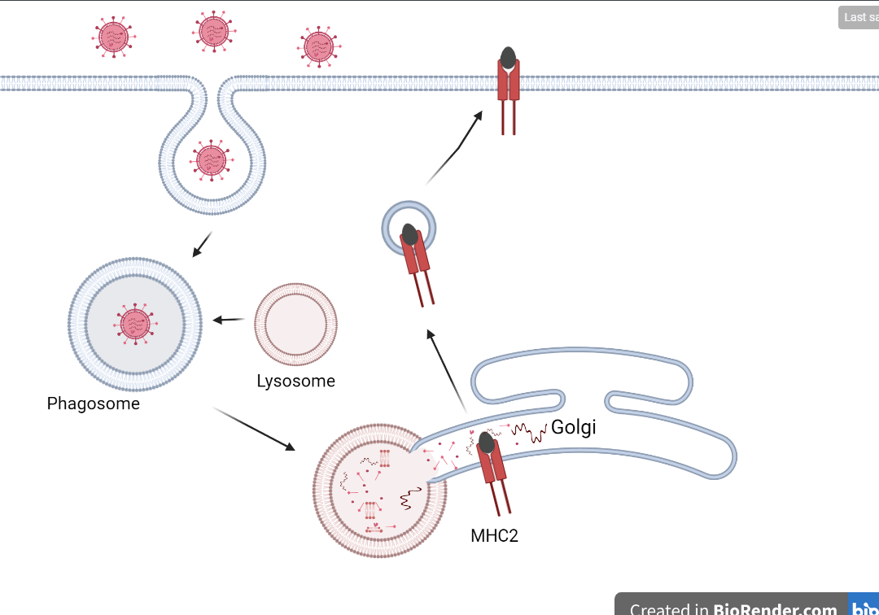

Slide 22
T-Cell activation
MHC2
TCR
Th Cell

Slide 23
T-Cell activation
IL4 receptor
IL4
TCR
Th Cell

Slide 24
T-Cell activation
IL4 receptor
IL4
TCR
Th Cell

Slide 25
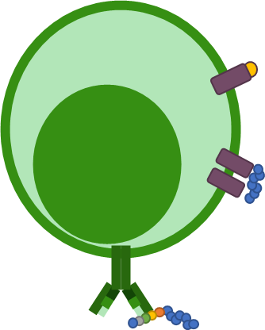
T-Cell activation
3
2
1
Effector cells
(plasma cells)
Memory cells
Circulation and tissue (Everywhere)
Lymph node

Slide 26
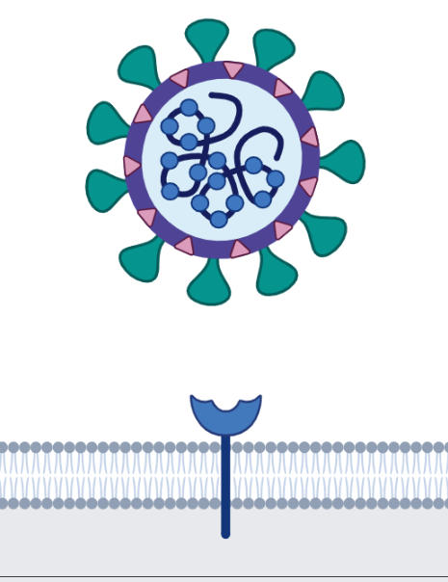
What do antibodies do?
Neutralisation

Slide 27
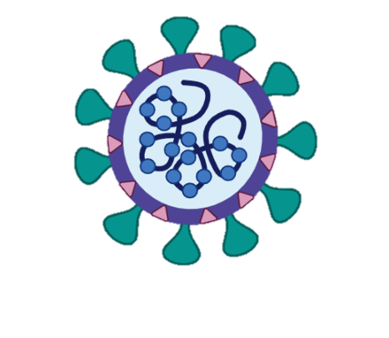
What do antibodies do?
Agglutination and precipitation
Cells and viruses ---------- Soluble antigens

Slide 28
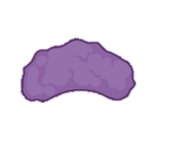
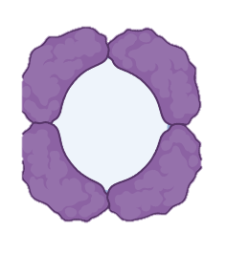
What do antibodies do?
Recruit and activate complement proteins
Membrane attack proteins that create pores

Slide 29
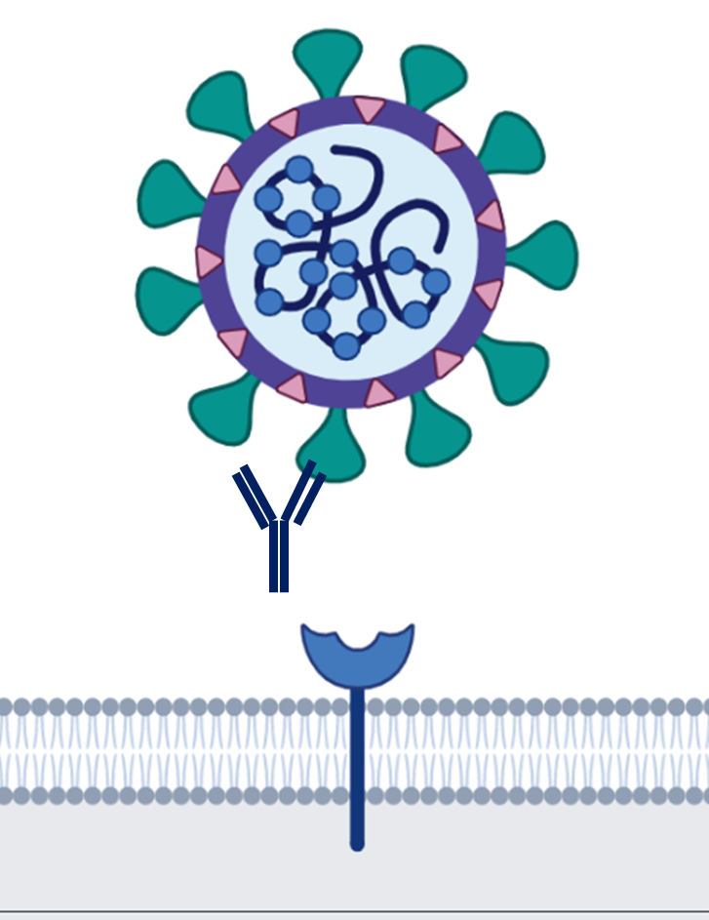
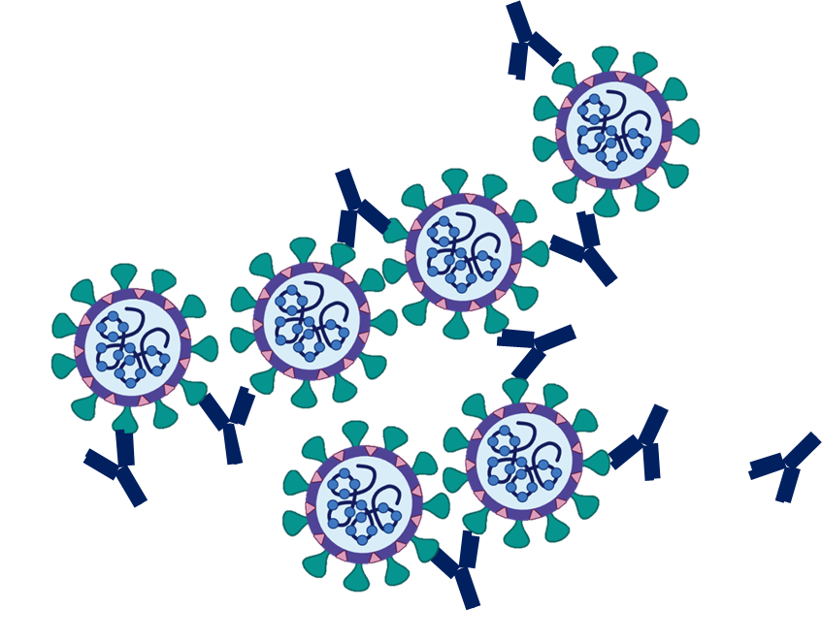
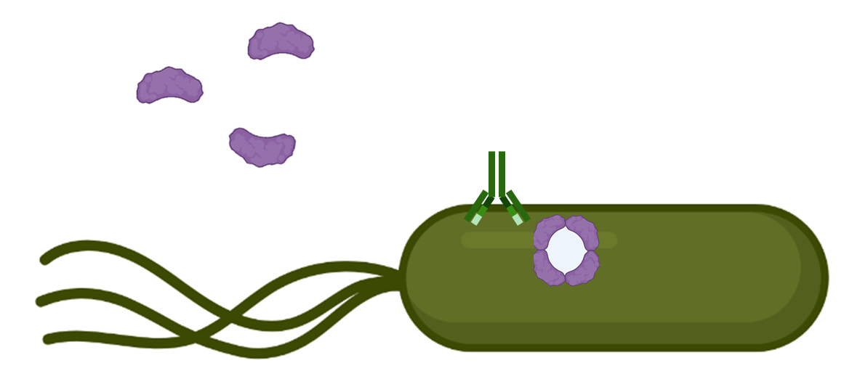
What do antibodies do?
Neutralise
Agglutinate
Precipitate
Complement

Slide 30
Up next T-Cells
IL4 receptor
IL4
TCR
Th Cell

Slide 31
The adaptive immune system
T cells
an introduction
The adaptive immune system

Slide 32
“The T cell”
The Th (Helper) Cell
The Tc (Cytotoxic) Cell
CD4+ T Cell
CD8+ T Cell
Memory Th Cell
Effector Th Cell
Memory Tc Cell
Effector Tc Cell
Th1
Treg
Th2
Th17

Slide 33
“The T cell”
The Th (Helper) Cell
The Tc (Cytotoxic) Cell
CD4+ T Cell
CD8+ T Cell

Slide 34
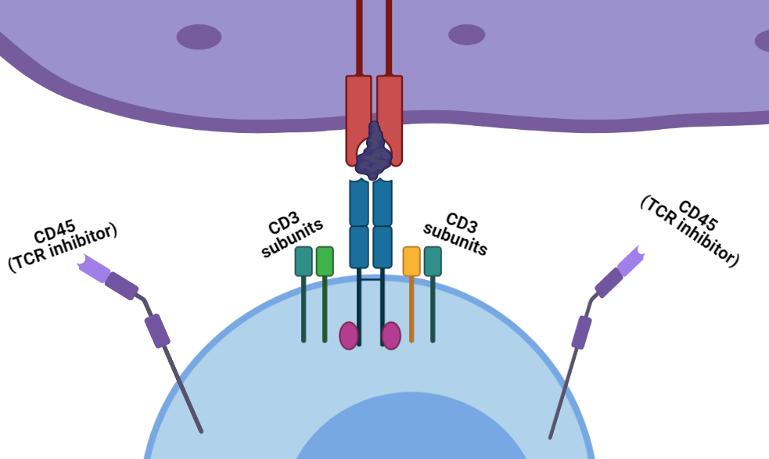
TCR
T cell receptor
MHC
TCR

Slide 35
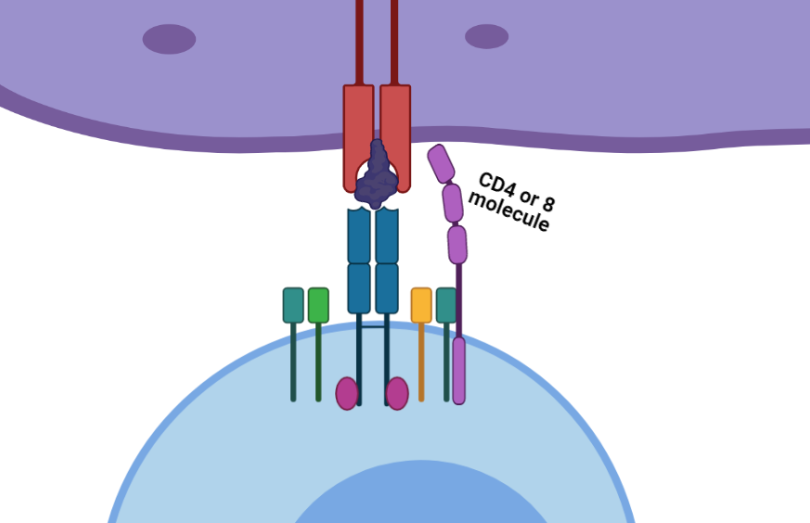
TCR
T cell receptor

Slide 36
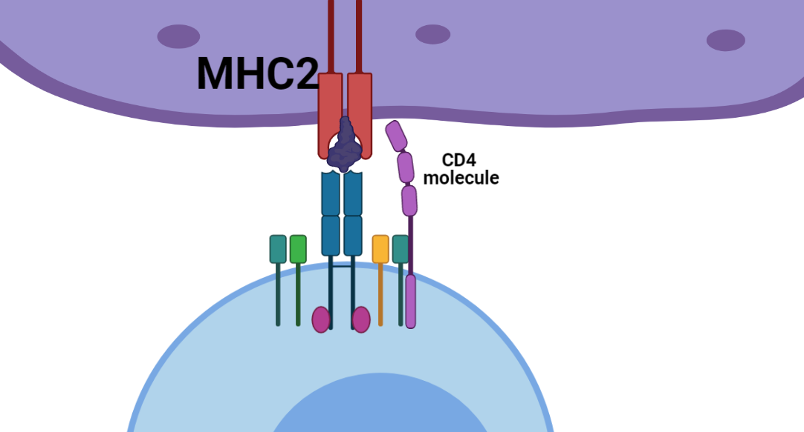
TCR
T cell receptor
The Th (Helper) Cell
CD4+ T Cell

Slide 37
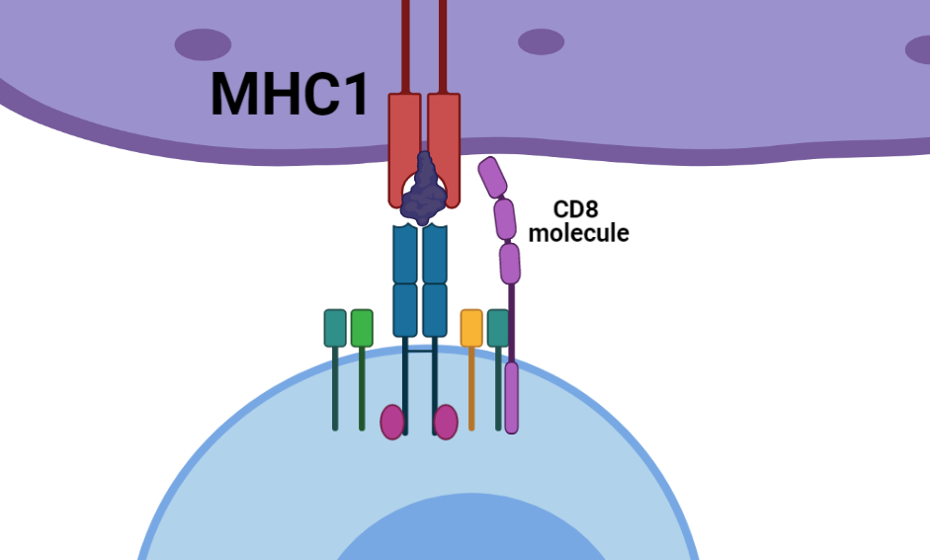
TCR
T cell receptor
The Tc (Cytotoxic) Cell
CD8+ T Cell

Slide 38
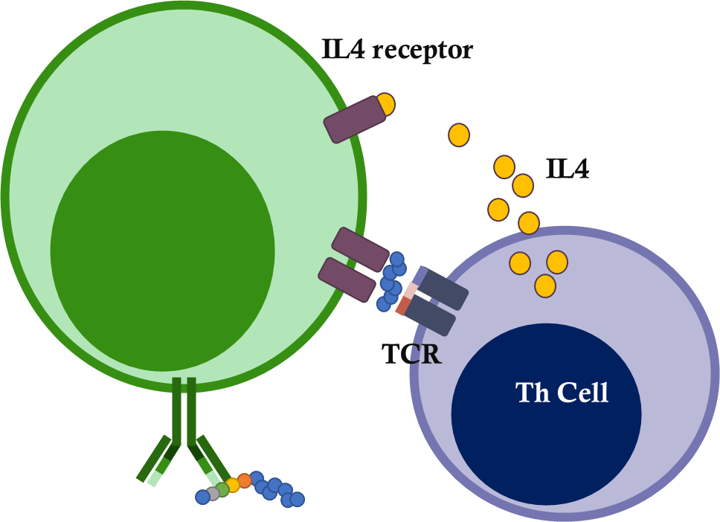
“The T cell”
The Th (Helper) Cell
The Tc (Cytotoxic) Cell
CD4+ T Cell
CD8+ T Cell
Activated by APC
Using MHC2
Activated by any cell
Using MHC1
Antigen recognition causes activation where they Help to regulate the immune response
Antigen recognition causes activation where they become toxic to the cell with the MHC1
B cell

Slide 39
The adaptive immune system
Cytotoxic T cells
The adaptive immune system

Slide 40
TCR
T cell receptor
The Tc (Cytotoxic) Cell
CD8+ T Cell

Slide 41
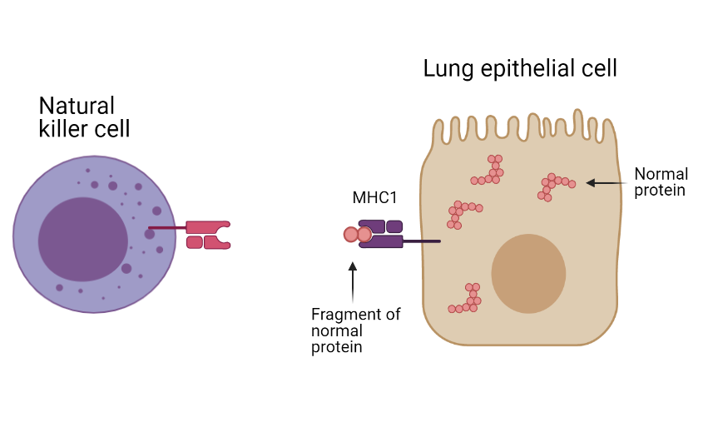

Slide 42
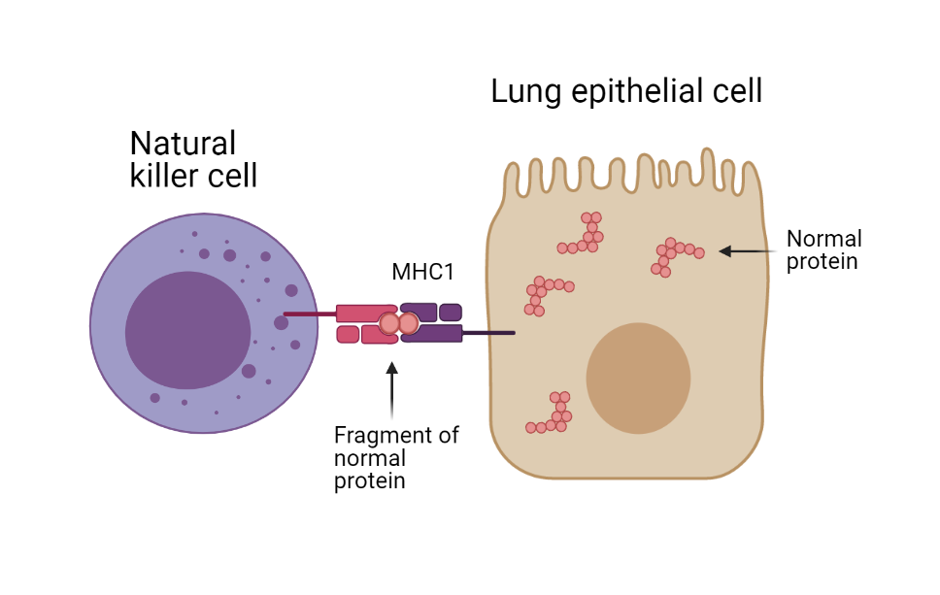
You will not die today

Slide 43
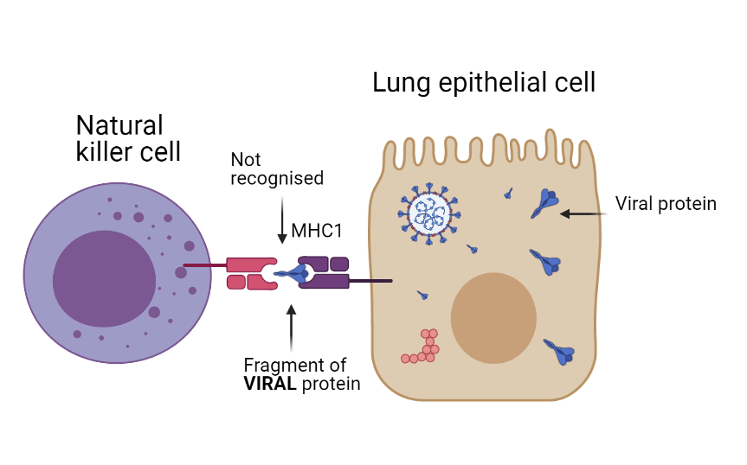

Slide 44
It’s granule time!

Slide 45
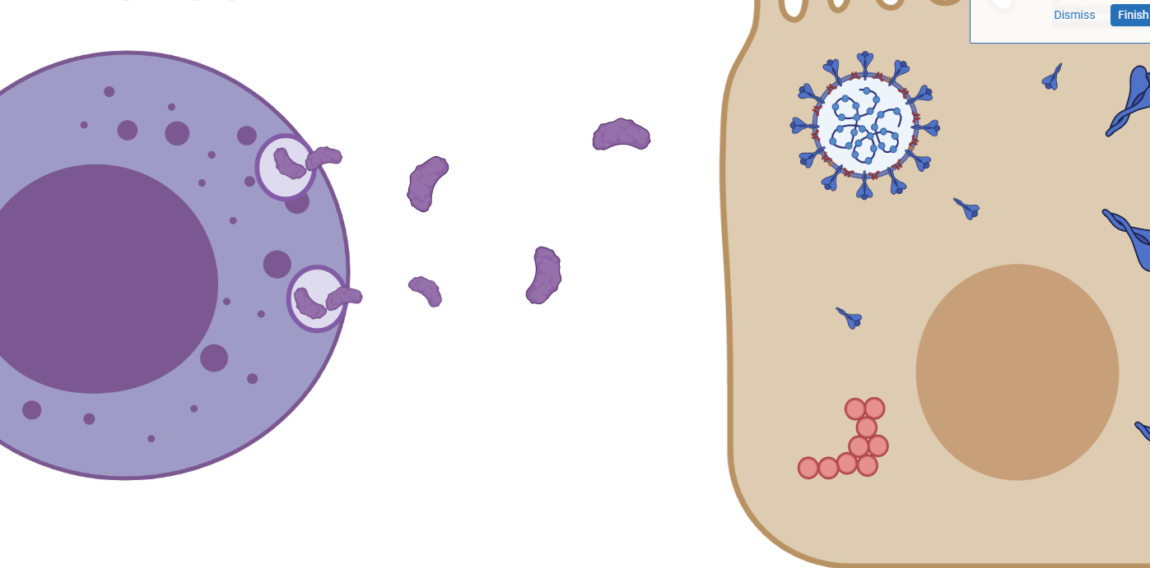
Perforin
(the perforator protein)

Slide 46
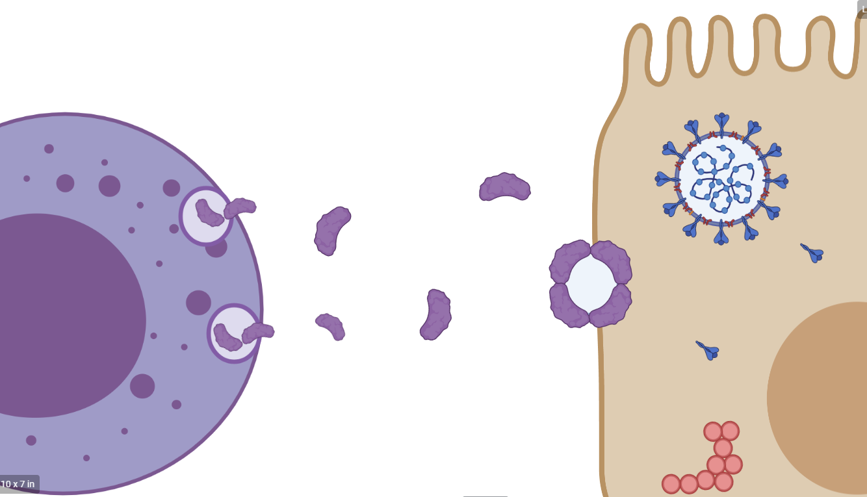
Perforin
(the perforator protein)

Slide 47
TCR
T cell receptor
The Tc (Cytotoxic) Cell
Recognition results in activation

Slide 48
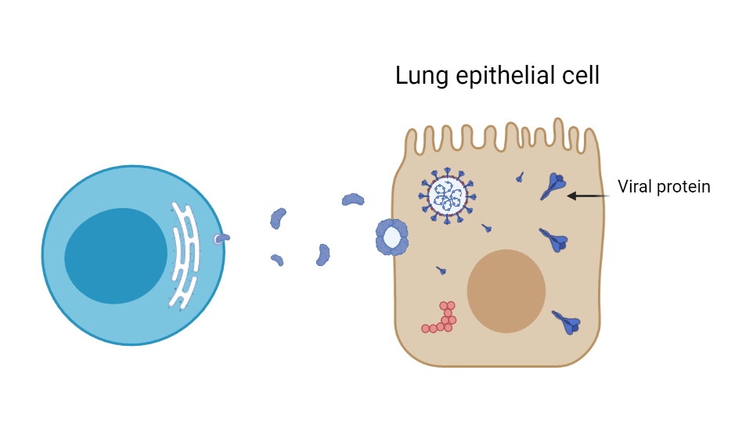
Perforin
(the perforator protein)
Tc Cell

Slide 49
Perforin
(the perforator protein)
Tc Cell
Effector Tc Cell
Memory Tc Cell

Slide 50
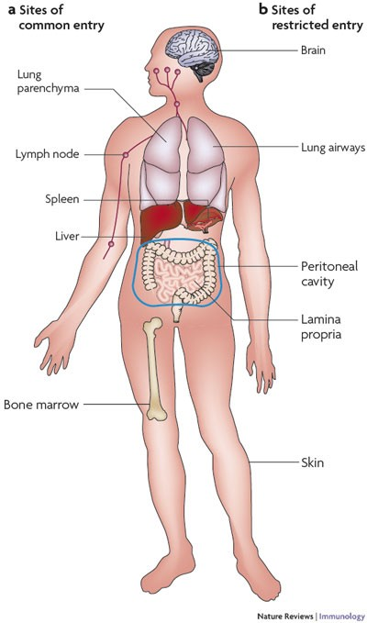
Tc Memory Cells
Woodland, D., Kohlmeier, J. Migration, maintenance and recall of memory T cells in peripheral tissues. Nat Rev Immunol 9, 153–161 (2009)

Slide 51
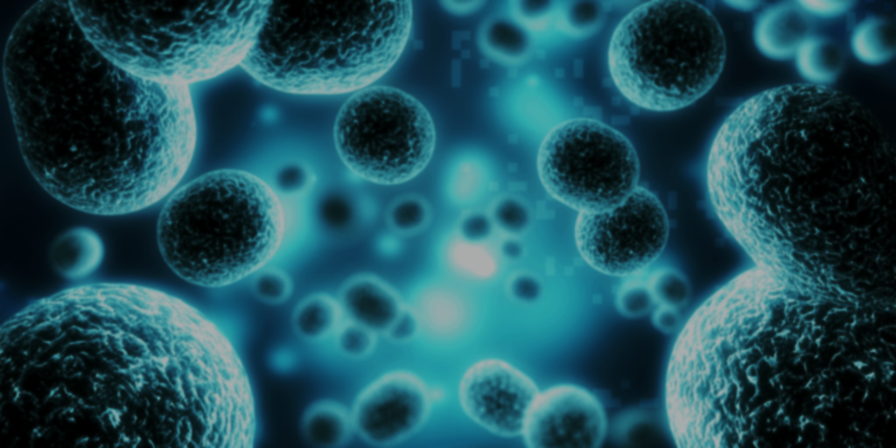
Cytokine Bead Assays

Slide 52
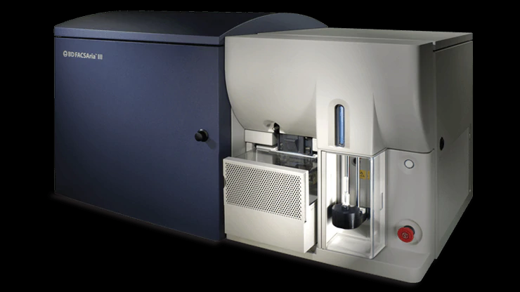
Flow cytometry machine

Slide 53
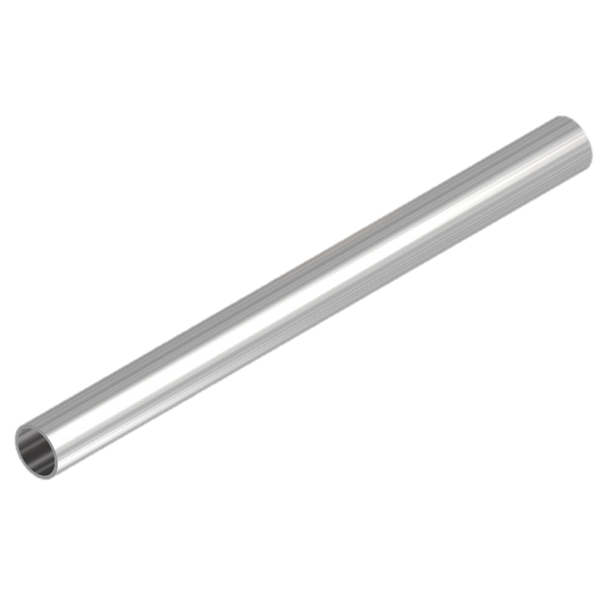
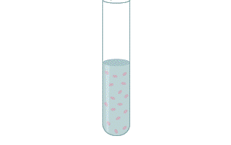
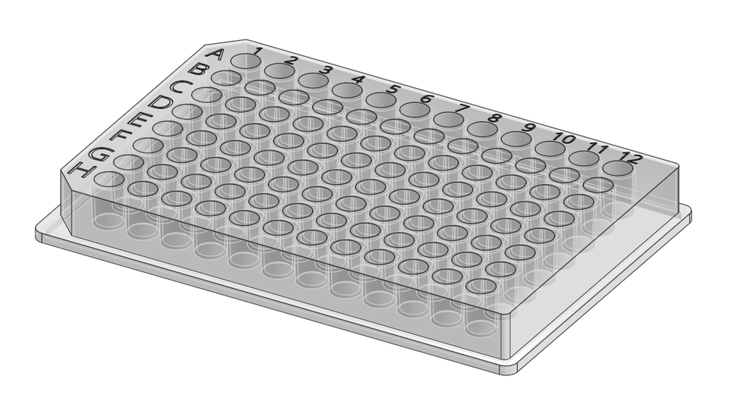

Slide 55
LASER
sensors
Forward scatter
~ Cell Size

Slide 56
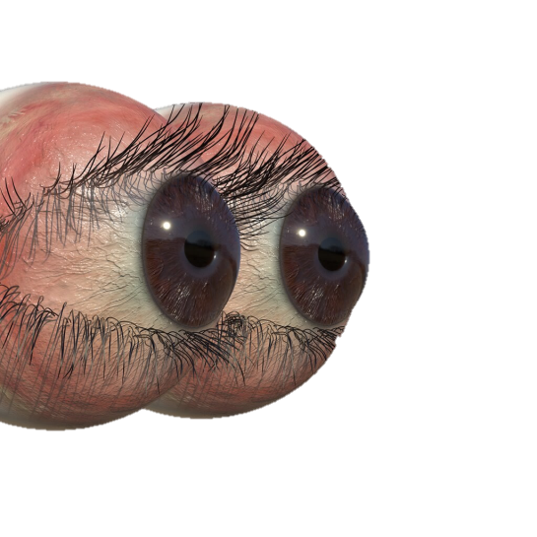
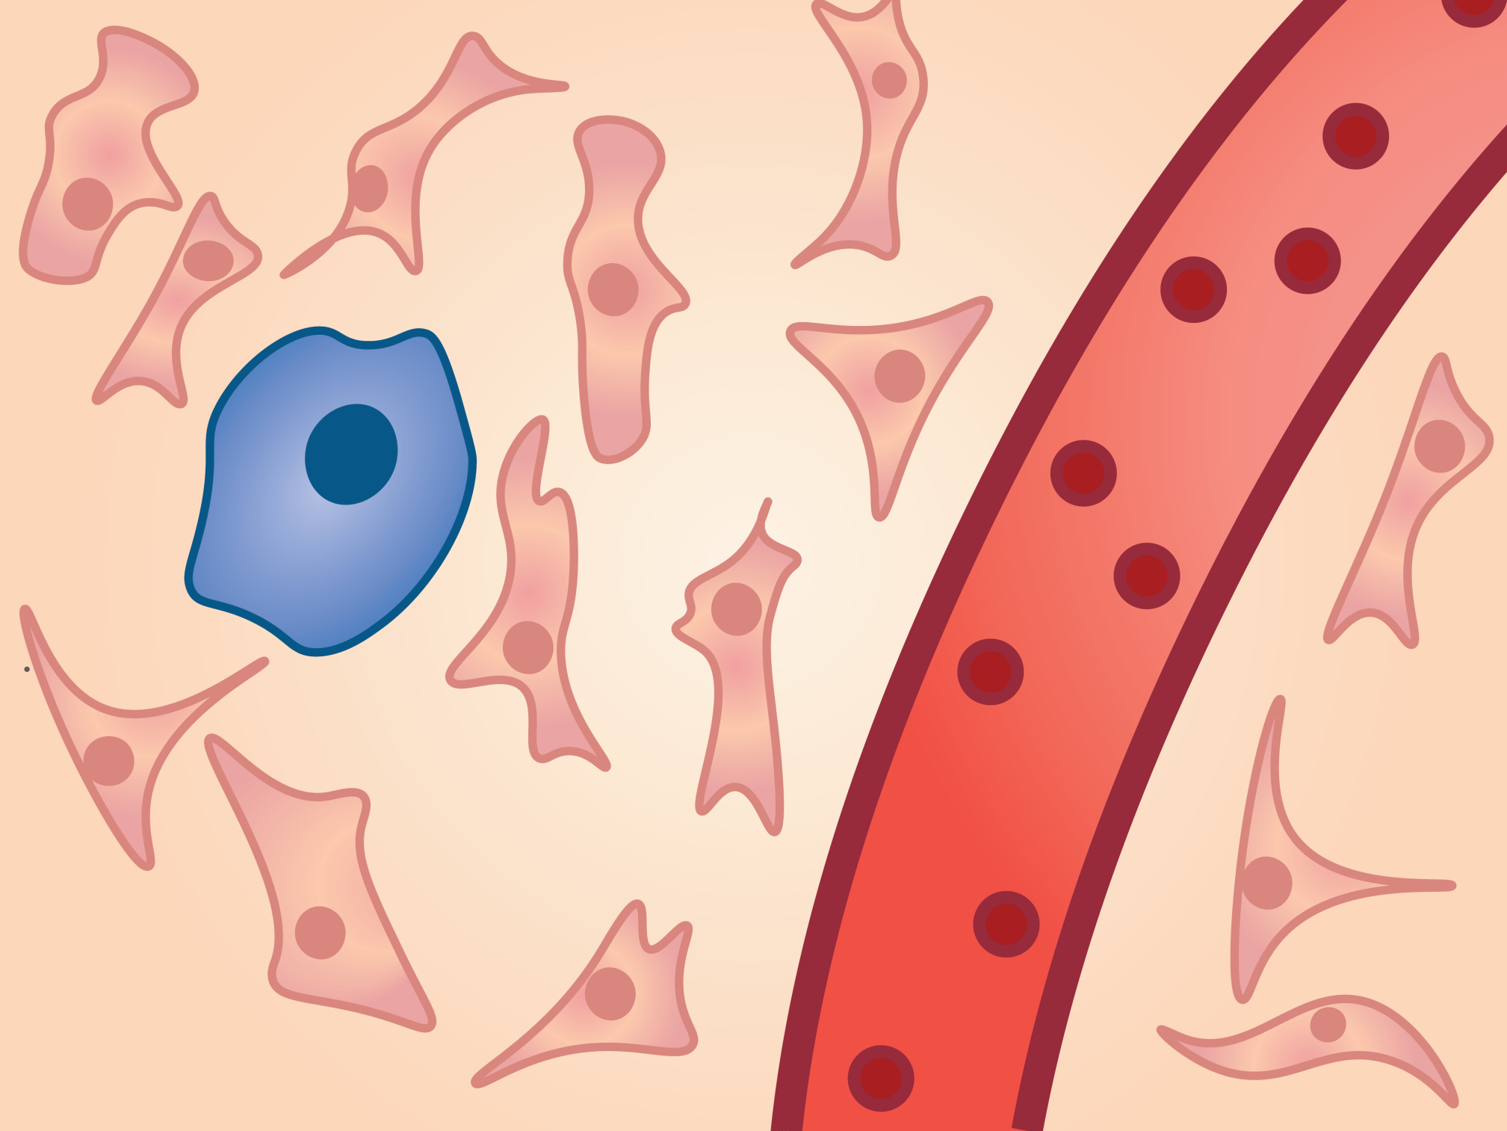

Slide 57
LASER
sensors
Filter
sensors

Slide 58
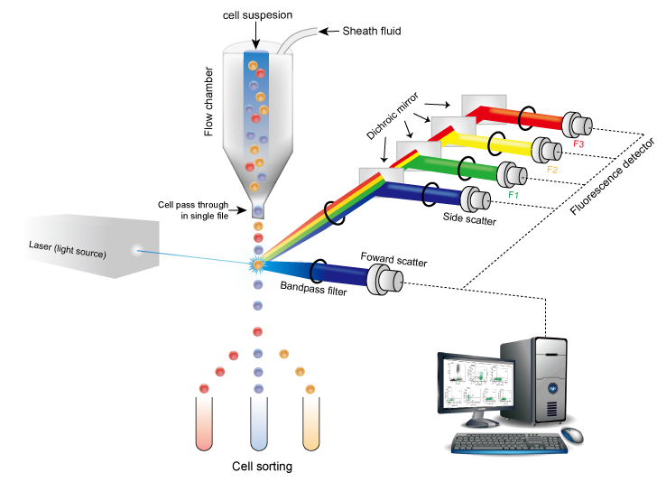
Filter and a mirror in one

Slide 59
Big and positive for MHC2
Forward scatter
~ Cell Size
Small and negative for MHC2
Small and positive for MHC2
Fluorescence
MHC2 Antibody

Slide 60
Forward scatter
~ Cell Size
Fluorescence MHC2 Antibody

Slide 61
What does this have to do with a Cytokine Bead Assay?

Slide 62
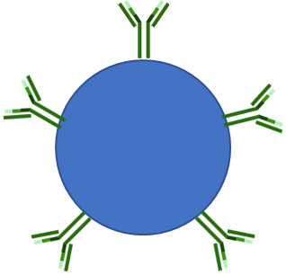
A Cytokine Bead Assay is an ELISA on a bead
Anti- IL6 Ab
Anti- IL1 Ab

Slide 63
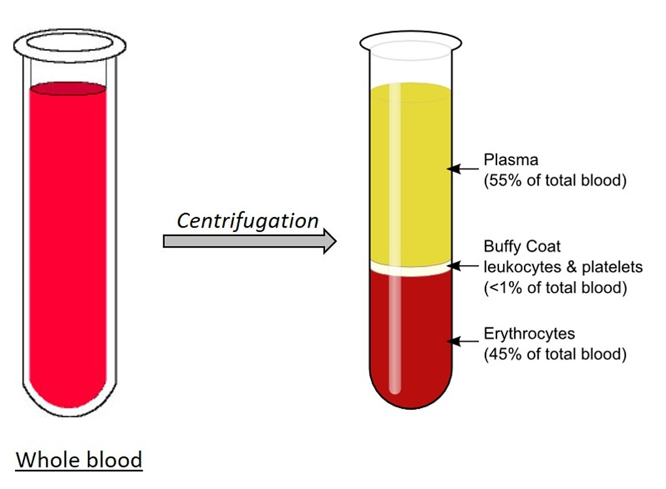

Slide 64
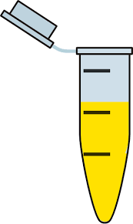
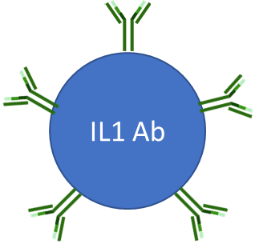
IL6 Ab

Slide 65
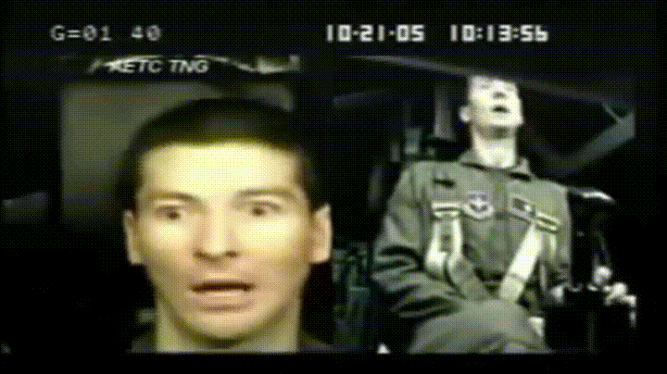
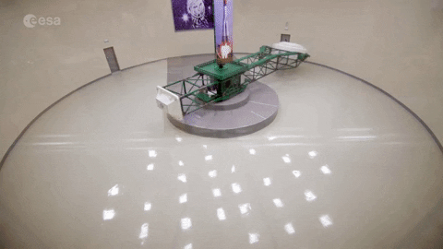

Slide 66
IL6 Ab

Slide 67
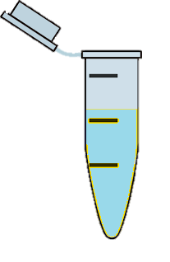
IL6 Ab

Slide 68
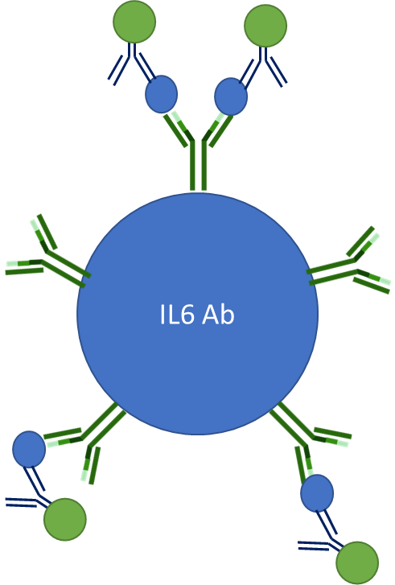
LASER
sensors
Filter
sensors

Slide 69
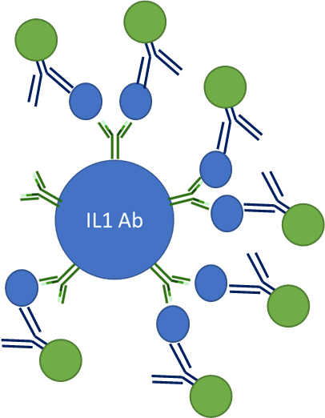
LASER
sensors
Filter
sensors

Slide 70
Big and slightly fluorescent
Forward scatter
~ Cell Size
Small and highly fluorescent
Fluorescence

Slide 71
A Cytokine Bead Assay is an ELISA on a bead
Anti- IL6 Ab
Anti- IL1 Ab

Slide 72
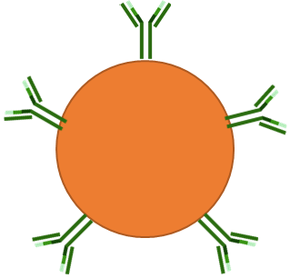
Anti- IL6 Ab
Anti- IL1 Ab
Anti- TNF Ab
Anti- IL2 Ab

Slide 73
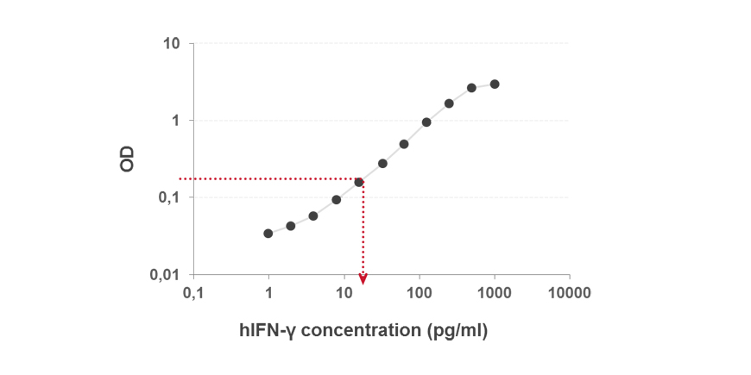
Standard curve for each cytokine
Fluorescence
Cytokine concentration (pg/ml)

